Slide 1
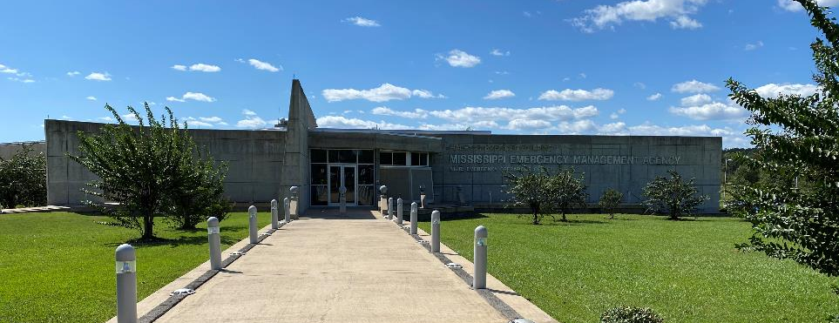
Speaking With The Media Presented by MEMA Office of External Affairs
PREPARING FOR TOMORROW’S DISASTERS TODAY

Slide 2
MUCH MORE THAN RESPONSE
WHY IS A PIO IMPORTANT?

Slide 3
MUCH MORE THAN RESPONSE
The Work of a PIO
Planning and Training
Executing

Slide 4
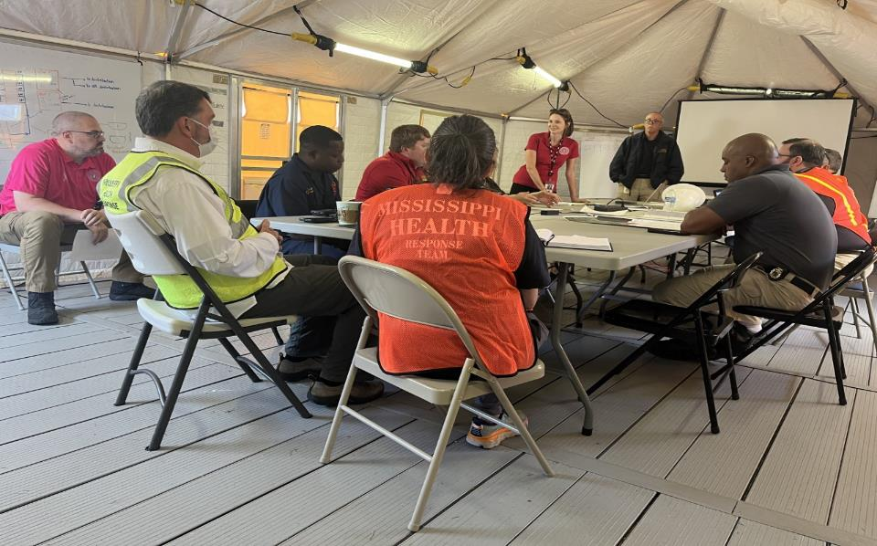
ALL HAZARDS THREATS
HOW TO MAKE AN ACTION PLAN?
Have an emergency messaging plan and have more than one person who can send the message out.
Collaborate with County Emergency Manager
Have a tabletop exercise
Have active shooter/bomb threat drill
Write policies for a potential call center or parent hotline, bus transfer plans (find drivers), reunification centers, and who will speak to the media.

Slide 5
MUCH MORE THAN RESPONSE
HOW DO I PLAN?
Have a written policy of who can speak to the media. Make sure there are backups.
Staffing identified for a call center and/or Joint Information Center
Have a written emergency message that can be pushed out to media, social media, text message alerts, and phone calls. Create a template message to help organize your thoughts:
“_____ School is/has experiencing/ed _______. To keep students safe the campus is on lockdown. No one is allowed to leave or enter the school grounds. Updates will be provided when available.”
Plan on not taking media questions during the first briefing. Let the media know what you know and tell them you will follow up when more is available. It allows for better planning and communication for the next briefing.

Slide 6
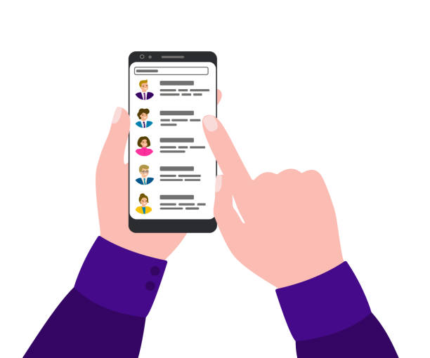
Contact Lists
PIOs should review and update all contact lists (media, PIOs, other agencies) every six months. Lists include information such as telephone numbers (office and cell phone), e-mail addresses, social media identifiers, and web addresses.

Slide 7
Risk Communication
Risk communication is the process of making the public aware of risks and of how to prepare for hazards in advance.
Before an incident occurs, PIOs should conduct activities to educate the public about potential local hazards, prevention, family preparedness, and response activities.
Education Campaigns
Brochures
Drills
Notes:
It is important for plans and resource materials to be appropriate for the target audience—for example, children, people with disabilities or AFN, people with LEP, pet owners, local businesses and employees, or entire communities.
PIOs can conduct risk communication through special events, community events, media releases, social media, and print materials or multimedia/digital content. Examples of risk communication campaigns include:
• All-hazards preparedness
• Family or business emergency plans
• Hazardous materials (HAZMAT) awareness
• Messaging for people with LEP, disabilities, or AFN
• Severe weather awareness
• Exit drills in the home

Slide 8
Joint Information Systems (JIS)
Public information leaders prepare for incidents by coordinating their processes, plans, protocols, procedures, and structures in advance. PIOs at all levels of government and within the private sector, nonprofit sector, and JICs are important supporting elements of the JIS. Key elements of the JIS include the following:
• Interagency coordination and integration
• Gathering, verifying, coordinating, and disseminating consistent messages
• Integrating messaging from various levels of incident management
• Providing public affairs support for decision makers
• Ensuring flexibility, modularity, and adaptability

Slide 9
PIO Function in the
Joint Information Center (JIC)
In JICs, PIOs create coordinated and consistent messages by collaborating to:
• Identify key information to be communicated to the public
• Craft clear messages in plain language that all can understand, including people with limited English proficiency (LEP), with disabilities, or with access and functional needs (AFN)
Prioritize messages to ensure timely delivery of information without overwhelming the audience
• Verify information accuracy
• Disseminate messages using the most effective means
Notes:
PIOs should provide messaging in multiple formats to meet the communication needs of people with disabilities or AFN, who have LEP, who have diverse cultural backgrounds, who have cognitive limitations, or who do not use traditional media.

Slide 10
Talking to the Media
WHAT SHOULD THE PIO BE DOING?
The PIO should not be the only one talking to the media. People want to hear from those in charge.
The PIO should be collecting information about what is being done on the scene from school officials and law enforcement.
Writing talking points for those speaking to the media.
Monitoring social media for any rumors or videos.
Posting information on social media about reunification centers, checkpoints, or a number to call for more information.
Communicating with other agencies to help make sure the message being put out are consistent.
Setting up press conference/media briefing areas.
Communicating with media about briefings or b roll opportunity.

Slide 11
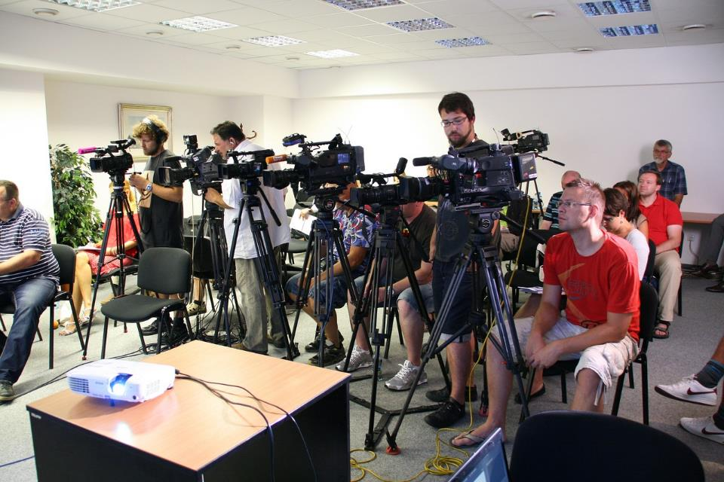
MUCH MORE THAN RESPONSE
WHAT DO I SAY?
Before anyone speaks introduce yourself. National and even local media may not know who you are.
State the threat.
Has the threat been eliminated?
Let people know where students are now or will be going.
What are we doing?
What have we done already?
If you don’t know what went on do not speculate, repeat rumors, or make things up. Video evidence will surface!

Slide 12
MUCH MORE THAN RESPONSE
WHAT DO I SAY?
Who, What, When, Where, Why, How
Before anyone speaks introduce yourself. National and even local media may not know who you are.
State the threat.
Has the threat been eliminated?
Let people know where students are now or will be going.
What are we doing?
What have we done already?
If you don’t know what went on do not speculate, repeat rumors, or make things up. Video evidence will surface!

Slide 13
MUCH MORE THAN RESPONSE
WHY SHOULD I SAY SOMETHING?
You need to say something to let people know you hear their concerns.
You oversee the student body, not law enforcement.
No comment is a comment whether you audibly say, “No comment.” or stay silent.
The public has a right to know what the school is doing.
Parents have a right to know where their children are.

Slide 14
Talking to the Media
TALKING TO THE MEDIA
DO
DON’T
Be straightforward and factual. Stick to your immediate role and assigned responsibilities
If you don’t know the answer, it is okay to say so. Tell them you’ll follow up and DO IT.
Responses to questions that involve multi-agency operations should be coordinated through the appropriate external affairs office.
Questions about policy and senior leadership decision-making should be directed to the correct leader or PIO.
Do not speculate about policy, controversial subjects, costs, extent of damages, timelines, etc.
When you talk to a reporter, ask for their name and media outlet and pass it on to the MEMA External Affairs.
Let your supervisor know that the media contacted you and/or that you need additional help.
Use the phrase “no comment”
Use technical terms, acronyms or long answers
Offer your opinion or personal beliefs
Make things up or speculate
Lose your cool or promise things
Get lured into friendly conversation
Start addressing their negative question
Apologize or attack
Fold arms or use wild hand gestures
Wear sunglasses during an interview

Slide 15
Talking to the Media
REMEMBER THE MESSAGE
PUBLIC
MEDIA
Am I safe?
How will this affect me?
What should I do?
Can you fix it?
Who caused this?
Who’s in charge?
How will you help this community?
Is it contained?
What can we expect?
What should we do?
How did it happen?
Who’s to blame?
What aren’t you saying?
What's next?

Slide 16
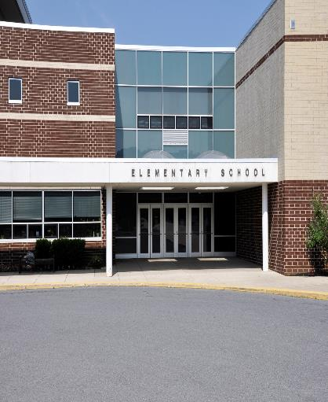
Talking to the Media
WHERE DO I PUT A REUNIFICATION CENTER?
There needs to be a reunification center where parents can have a checkpoint.
Preferably indoors (elements, media, airspace, other threats)
Have a backup plan in case of an incident or threat in the planned reunification center.
Have plenty of space for all students so a head count can be done.
Take into consideration bathrooms.
If it cannot be at the school consider somewhere close in distance.
Make sure there is space for buses in case there needs to be a bus transport of students to another location or the bus schedule resumes.

Slide 17
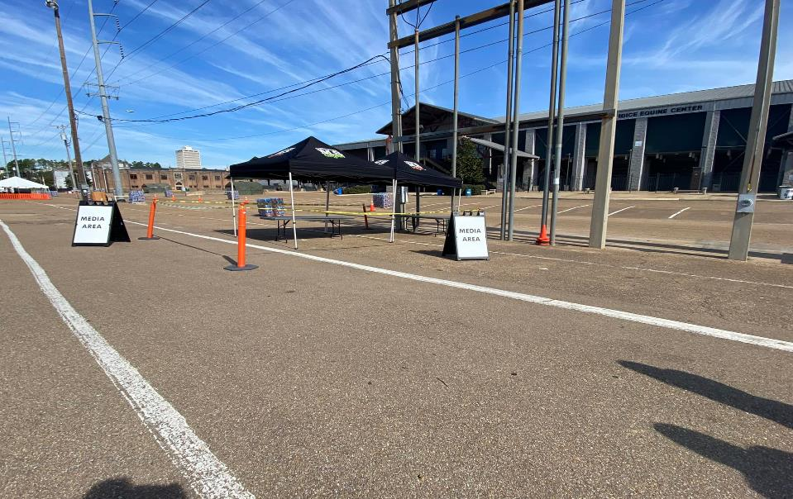
Talking to the Media
WHERE DO I PUT THE MEDIA?
A media staging area can help get all reporters/media in one place to keep them from roaming school grounds.
This staging area needs to be close enough to get B-Roll of what is happening. (Feed the beast)
If possible, let the media see an arrest being made or a department resolving a situation.
Keep the staging area close in distance to the media briefing area. (They can be the same)
Secure the proximity of the staging area with tape or signs so the media knows where they can set up.

Slide 18
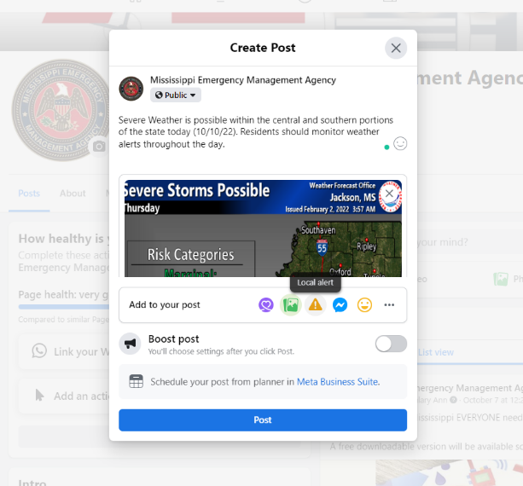
ALL HAZARDS THREATS
Facebook – Local Alert
Local Alert: Targets the audience in your area whether they follow you or not.
Anyone in that area will see the local alert

Slide 19
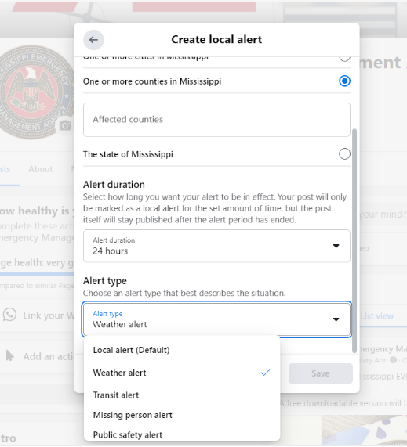
ALL HAZARDS THREATS
Facebook – Local Alert
Affected Area
Alert Duration
Alert Type
Save
Post

Slide 20
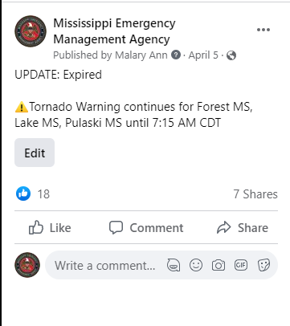
ALL HAZARDS THREATS
Facebook – Local Alert

Slide 21
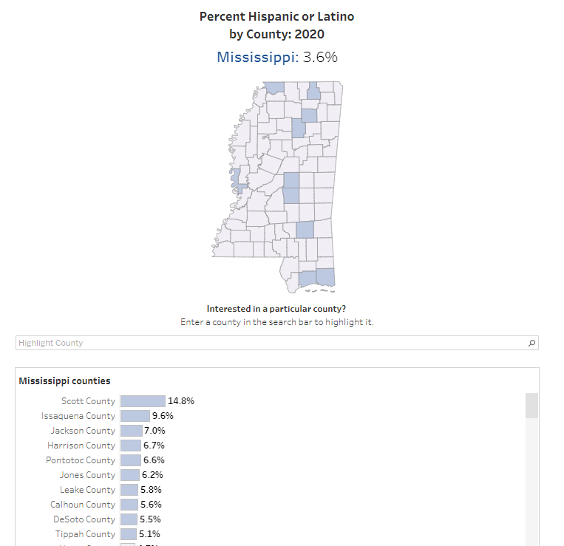
ALL HAZARDS THREATS
MESSAGING FOR EVERYONE
Source: 2020 Census

Slide 22
ALL HAZARDS THREATS
Lessons Learned
What You Post on Social is Considered “Official Information”
Respond to comments on social media only to correct misinformation or answer a basic question
Correct a social media post when needed, and say why you corrected it*
Date your post if using the word “today” or “tomorrow” due to algorithms and users seeing it later than intended

